Slide 1
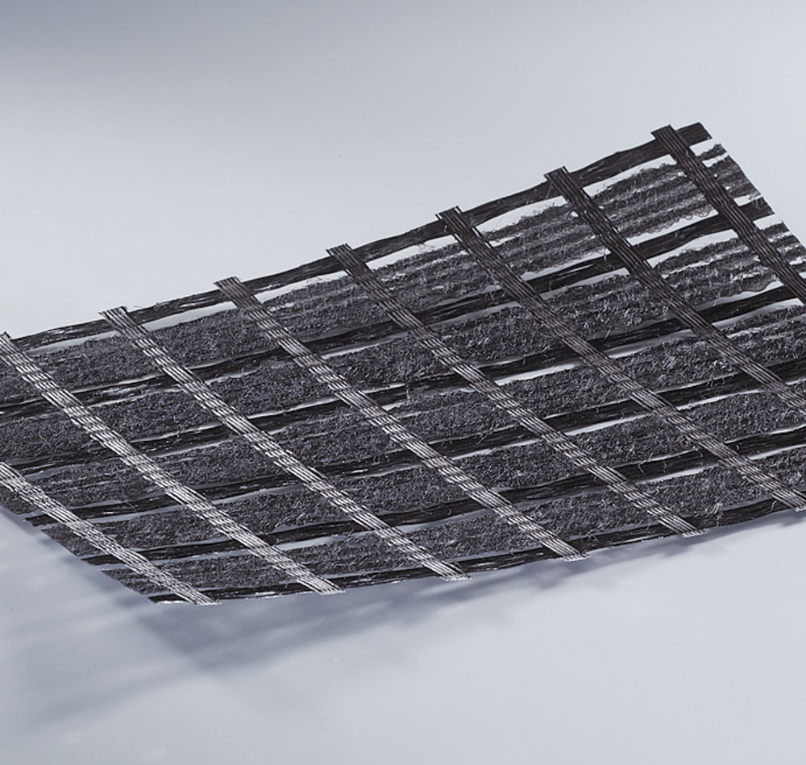
BEBIT – BEBIT G Plus
GEOSYNTHETICS – ASPHALT REINFORCEMENT

Slide 2
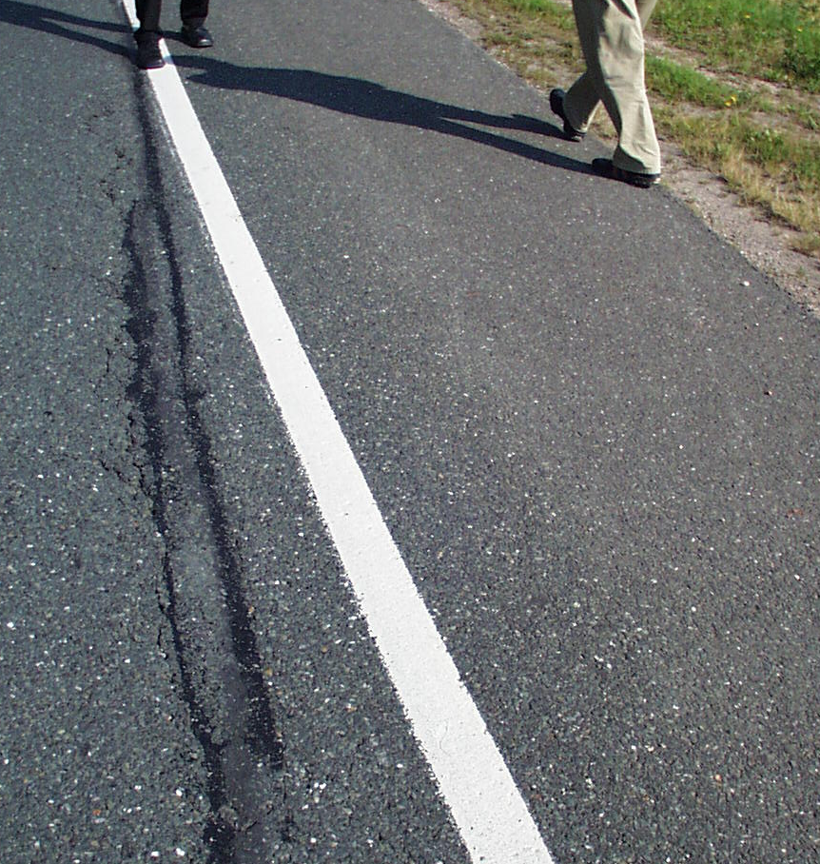
BEBIT – BEBIT G Plus installation
Cracking is a well known problem in bituminous road surfaces
Cracking can result from different causes:
  heavy load
  Soft subgrade
poor construction of the road surface
variations in temperature / freeze - thaw cycles
GEOSYNTHETICS – ASPHALT REINFORCEMENT

Slide 3
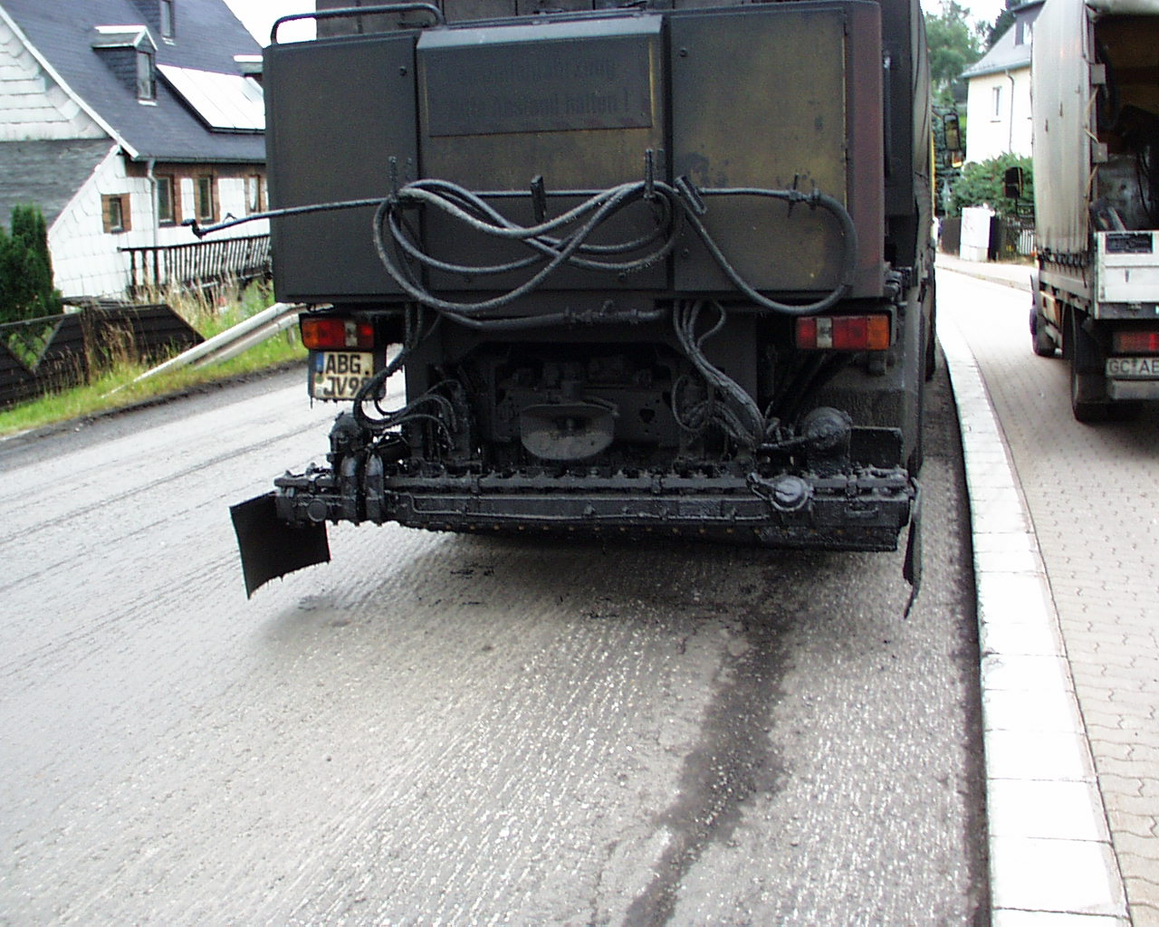
BEBIT – BEBIT G Plus installation
The surface should be smooth and clean.
Cracks and holes have to be filled and compacted.
GEOSYNTHETICS – ASPHALT REINFORCEMENT

Slide 4
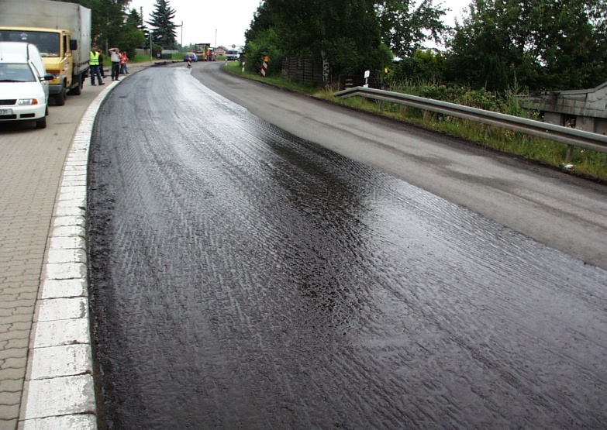
BEBIT – BEBIT G Plus installation
The surface must be dry and the temperature should be +10° C minimum
The reconstructing area is to be sprayed with a PmB tackcoat with an amount of 60 - 70 % bitumen. The softening point of the Emulsion has to be 10 °C over the temperature of the reconstructing area at the time of the installation.
The amount of tackcoat depends on the surface. For flat surfaces is about 500 to 800 g/m², for grades of up to a maximum of 8% decline or very porous surfaces tack coat up to 1000 g/m² can be needed.
GEOSYNTHETICS – ASPHALT REINFORCEMENT

Slide 5
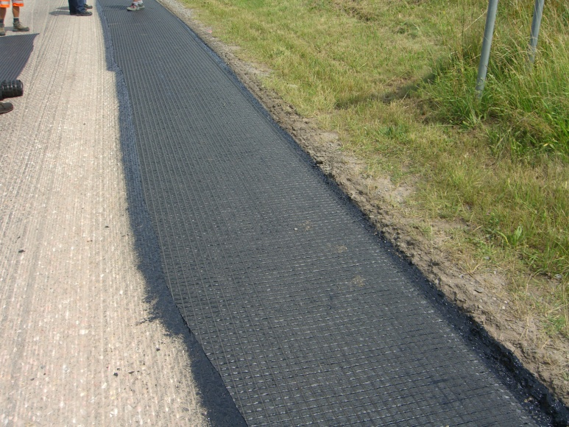
BEBIT – BEBIT G Plus installation
After the tack coat becomes sticky (the colour of the tackcoat turns from brown into black) Bebit G Plus can be rolled out and pressed on with a brush.
To reach an ideal adhesion the width of the sprayed area should overlap the total width of Bebit G Plus about 15 cm each side.
GEOSYNTHETICS – ASPHALT REINFORCEMENT

Slide 6
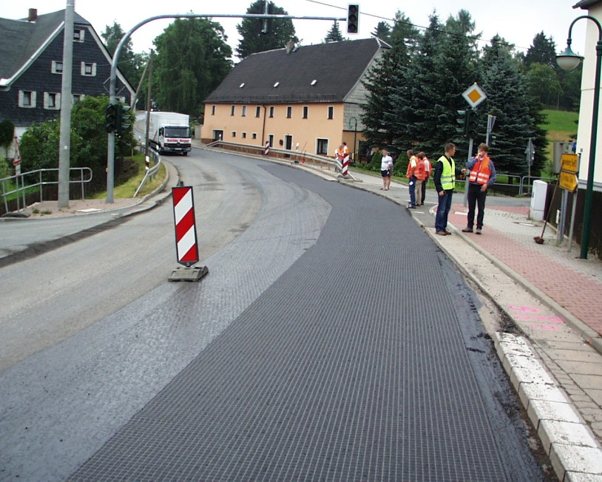
BEBIT – BEBIT G Plus installation
Drapes and wrinkles during installation of Bebit G Plus have to be avoided
In sharp curves or special requirements the grid can be cut in sections
If there are still drapes or wrinkels, Bebit G Plus should be cut, layed flat, sprayed with some extra tack coat and overlapped in the work flow direction
GEOSYNTHETICS – ASPHALT REINFORCEMENT

Slide 7
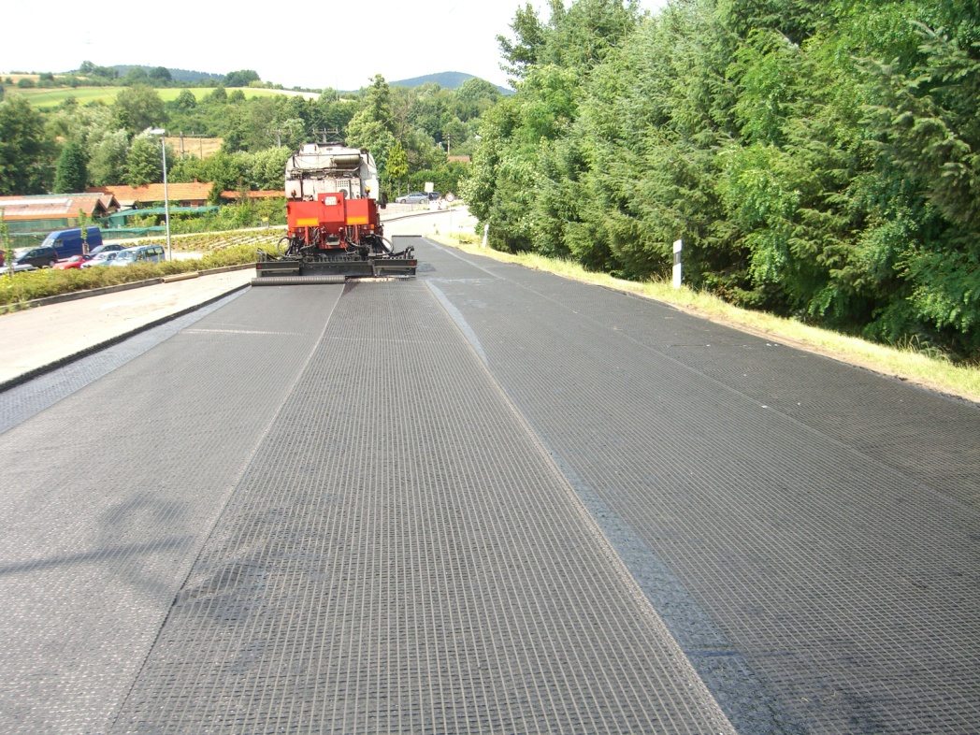
BEBIT – BEBIT G Plus installation
The overlapping of long-itudinal and diagonal connections should be at least 10 cm
The overlapping area has to be filled up with tackcoat
The overlapping should also be done in the work flow direction
work flow direction
overlapping
10 cm
After installation of Bebit G Plus there shouldn’t be any traffic except the asphalt paver and its supplier trucks
GEOSYNTHETICS – ASPHALT REINFORCEMENT

Slide 8
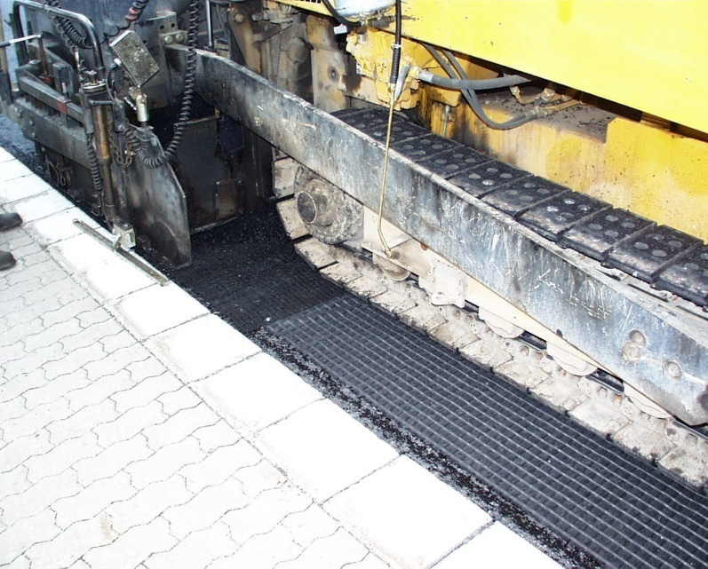
BEBIT – BEBIT G Plus installation
The tackcoat has to be dry completely before the paver is installing the new asphalt layer
It is important that road work vehicles minimise hard breaking and turning
Hard truck stops and sharp turns can damage the grid
The asphalt should have a thickness of at least 5 cm on top of BEBIT G Plus
GEOSYNTHETICS – ASPHALT REINFORCEMENT

Slide 9
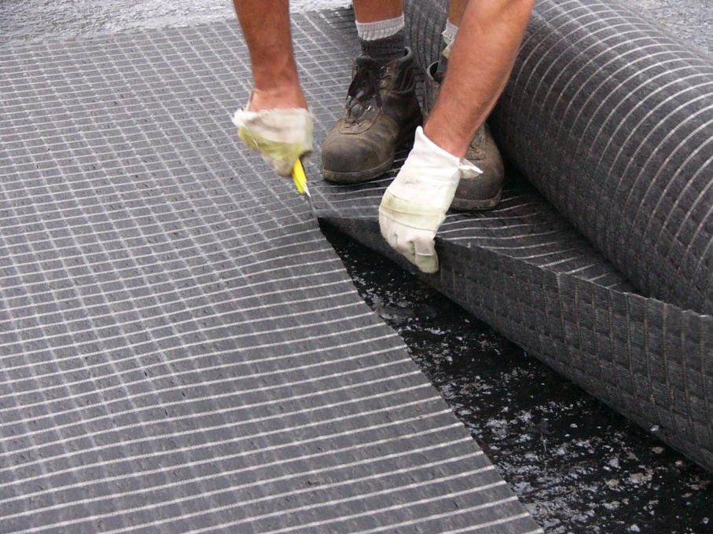
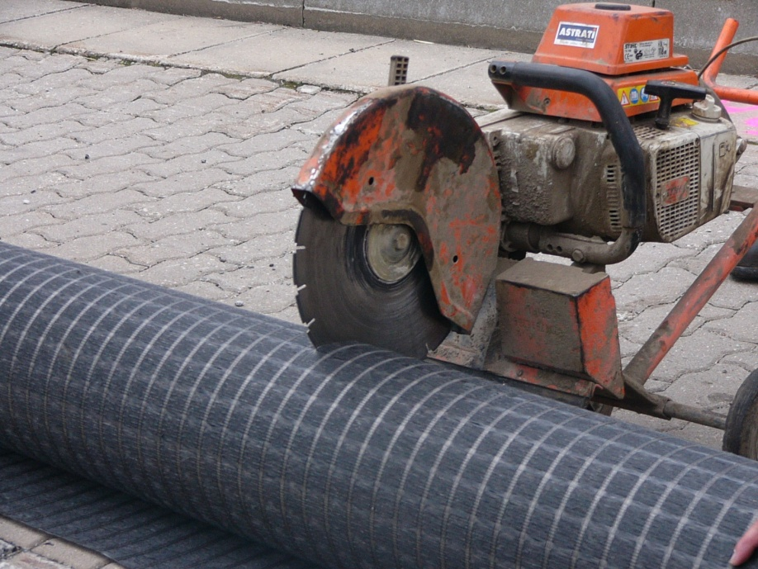
BEBIT – BEBIT G Plus installation
Easy to cut with a saw or a knife
GEOSYNTHETICS – ASPHALT REINFORCEMENT

Slide 11
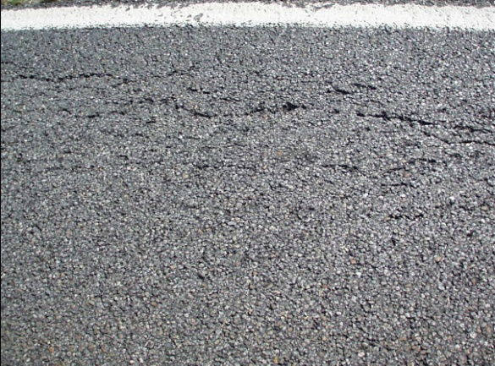
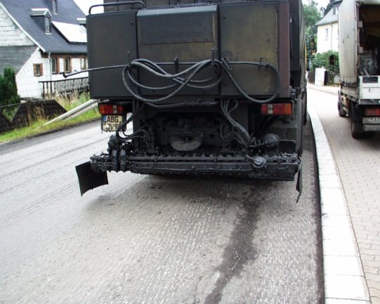

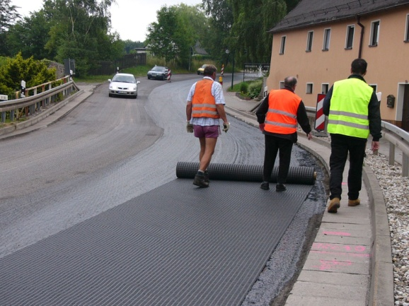
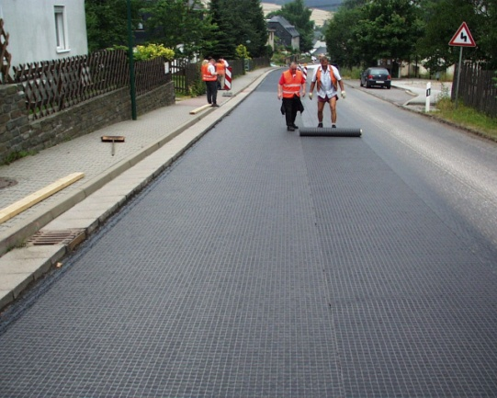

BEBIT – BEBIT G Plus installation
GEOSYNTHETICS – ASPHALT REINFORCEMENT

Slide 12

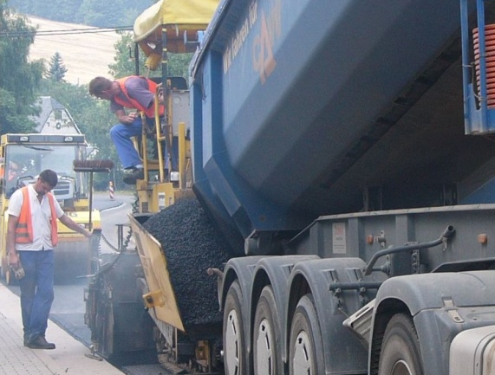
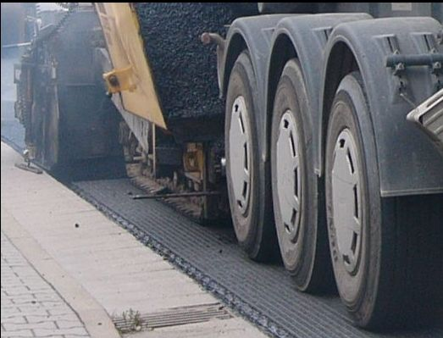
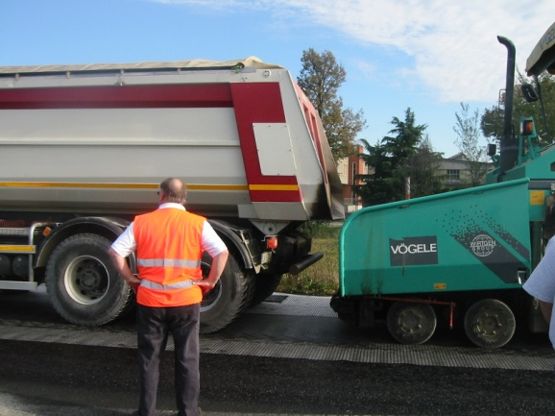
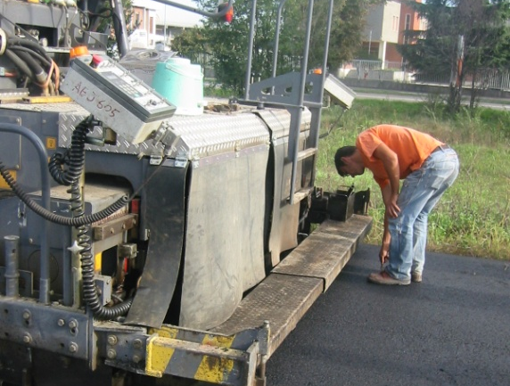
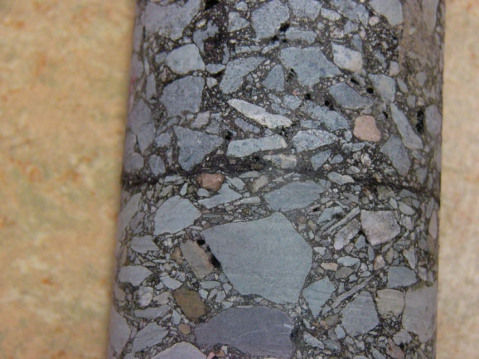
BEBIT – BEBIT G Plus installation
GEOSYNTHETICS – ASPHALT REINFORCEMENT

